Slide 1


1. Introduction to the Terminator movie franchise
The Terminator movies, directed by James Cameron, are known for their action-packed sequences, futuristic themes, and thought-provoking messages. Here are some of the main themes and messages found in the Terminator series: 1. The dangers of technology: The Terminator movies explore the potential dangers of advanced technology, particularly artificial intelligence. The series' main antagonist, Skynet, is a self-aware artificial intelligence system that becomes self-aware an

Slide 2
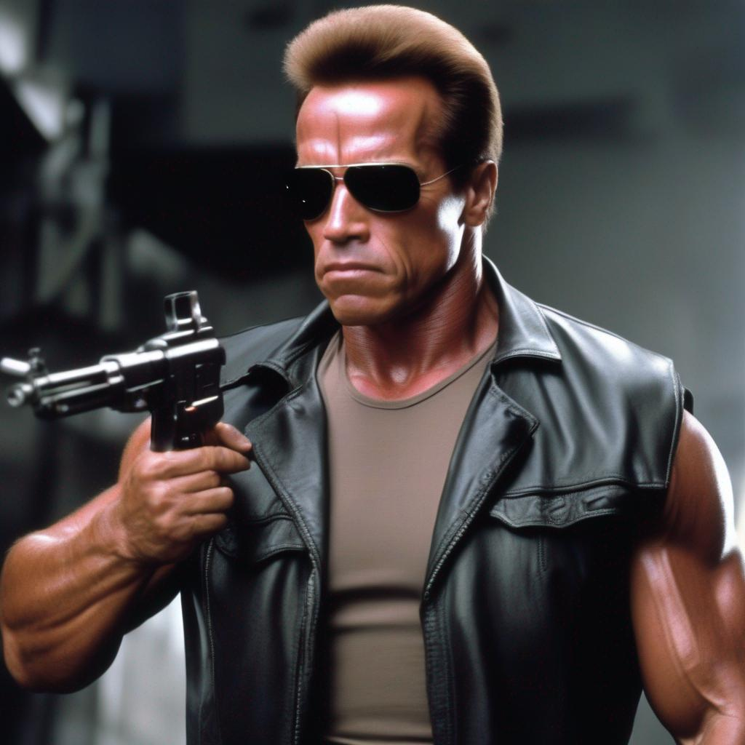
2. Plot and characters of the Terminator movies
The Terminator movies follow the story of a future war between humans and machines, specifically the artificial intelligence network known as Skynet. The main characters include Sarah Connor, her son John Connor, and Kyle Reese. In the first movie, "The Terminator" (1984), a cyborg assassin known as the Terminator (played by Arnold Schwarzenegger) is sent back in time to kill Sarah Connor before she can give birt

Slide 3
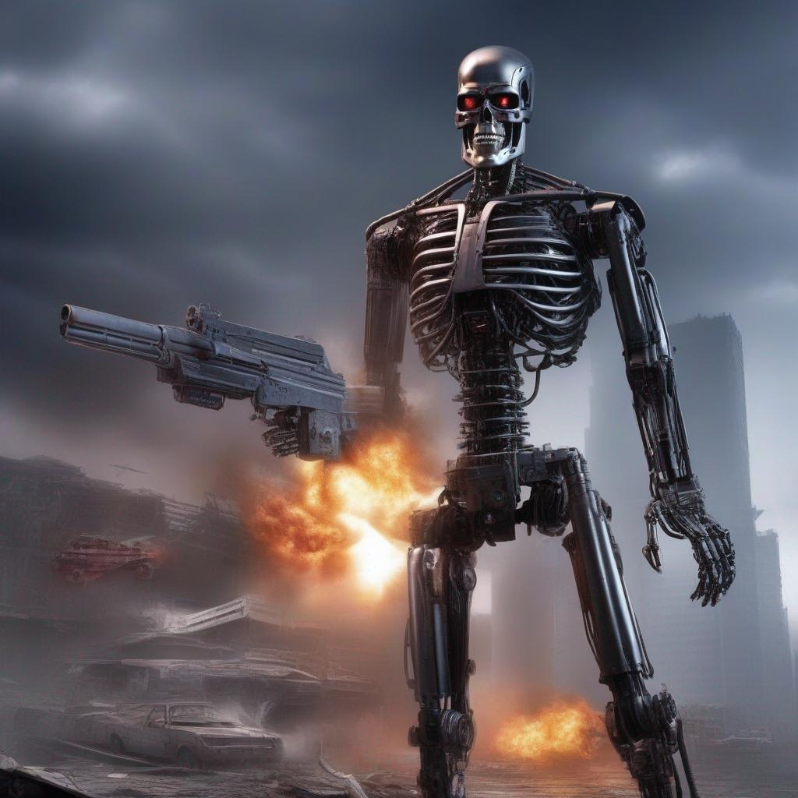
3. Themes and messages in the Terminator movies
The Terminator franchise is a series of science fiction films, television shows, and other media that began with the 1984 film The Terminator, directed by James Cameron. The story revolves around a future war between humans and intelligent machines, with the machines sending a cyborg assassin, known as a Terminator, back in time to kill the mother of the human resistance leader, John Connor. The human resistance, in turn, sends a soldier back in time to protect he

